Slide 1
Db present

Slide 2
Business Rules
An account can reserve many books. A book reservation belongs to only one account.
An account can make payment on many fine. A fine can only be paid by one account.
A book reservation can reserve many books. A book can be reserved by many books.
A book reservation can have one or no fine. A fine only belongs to a book reservation.
A report obtains all information from payment record.
A report obtains all information from book reservation record.

Slide 3
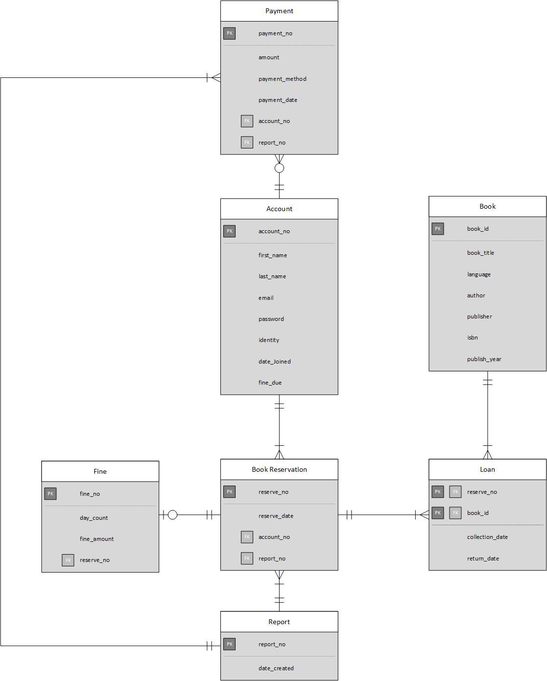

Slide 4
Organization Structure

Slide 5
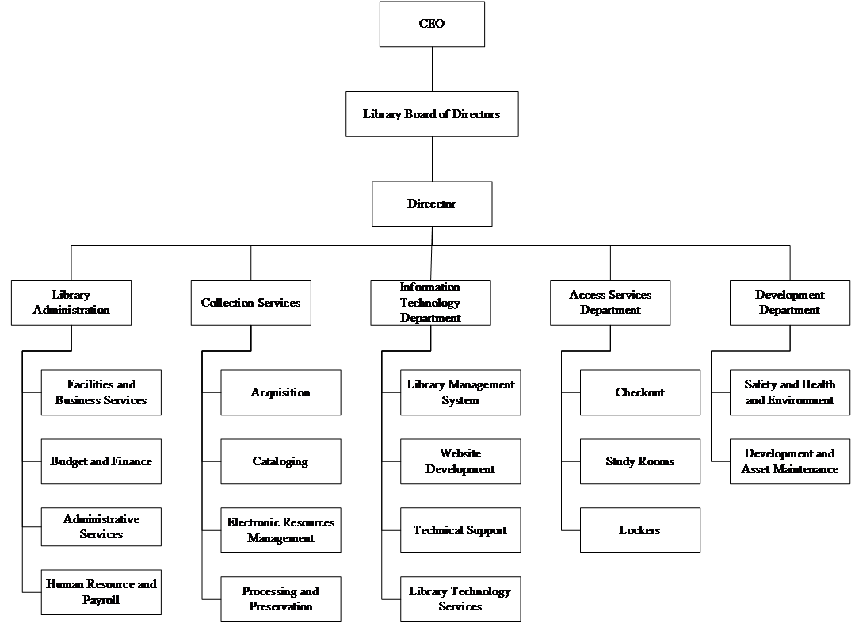

Slide 6
Functional Diagram

Slide 7
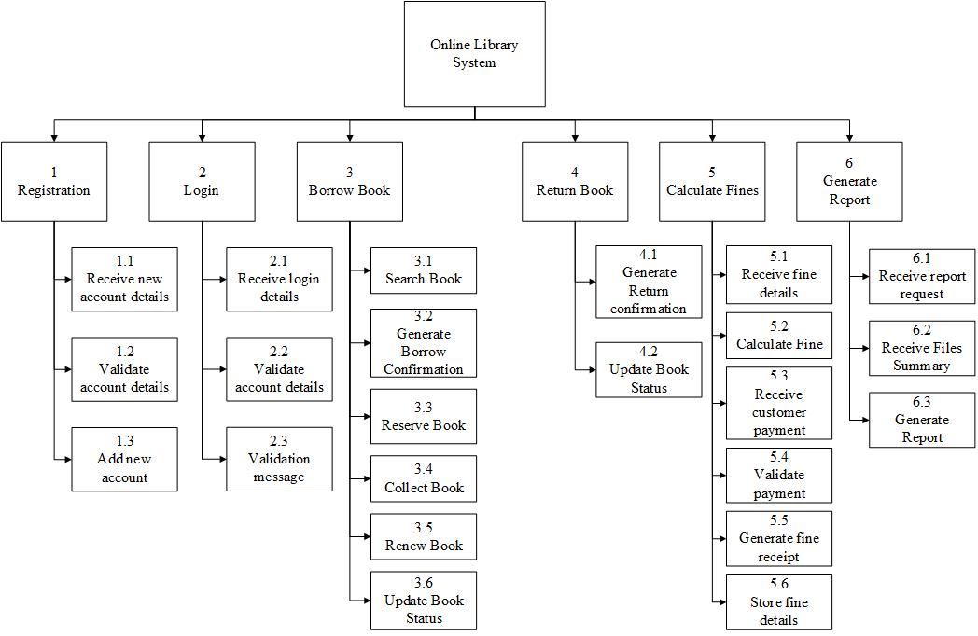

Slide 8
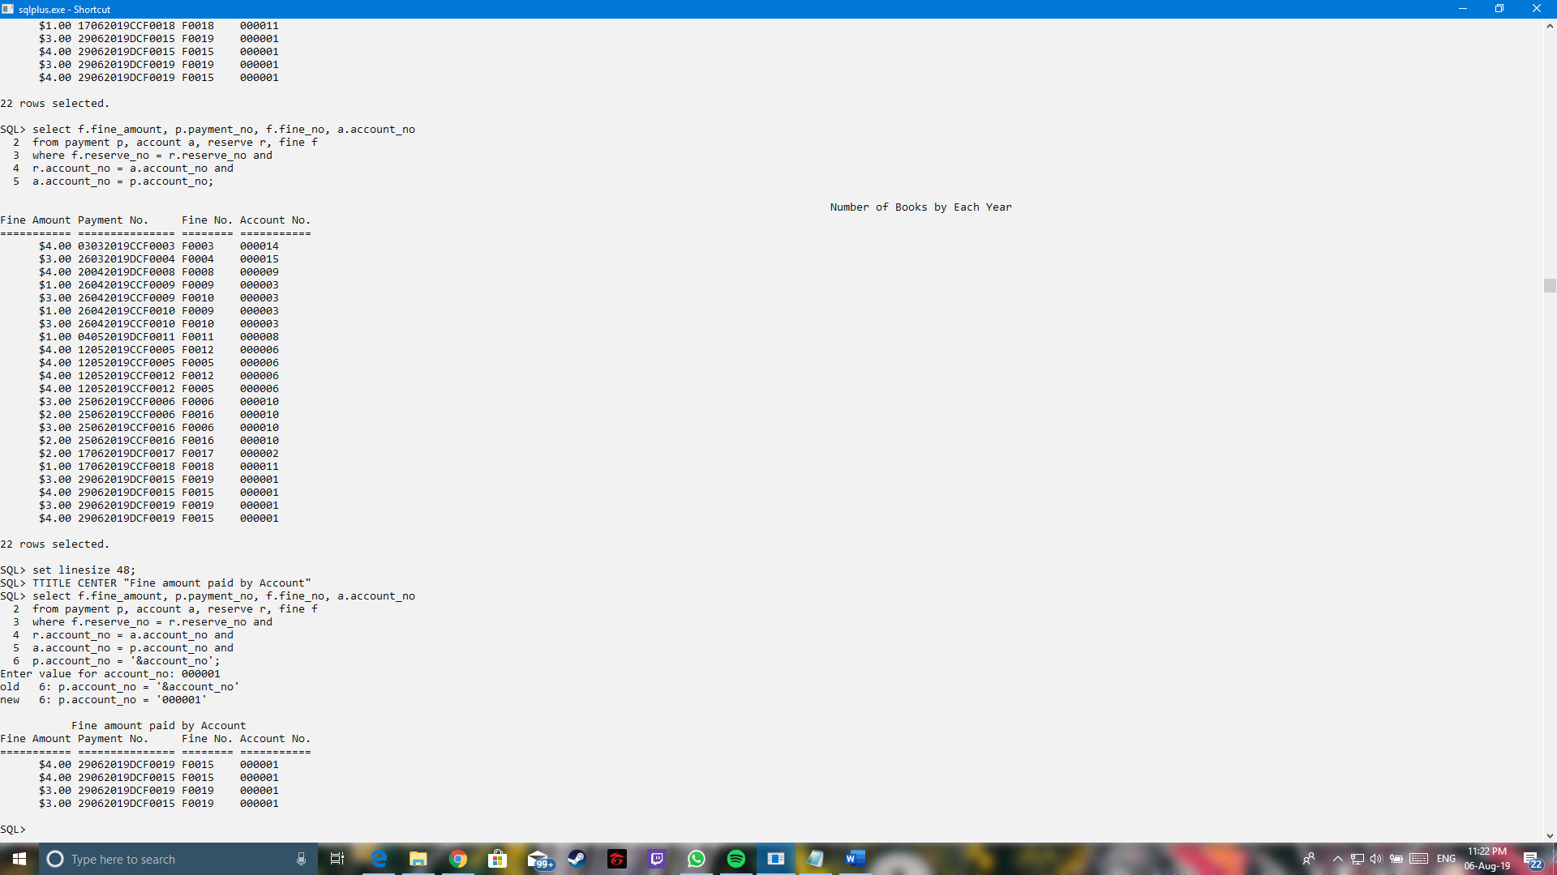
Queries
Purpose:
To make the user easier to search for fine amount paid by certain accounts. This function can be used to increase the efficiency of the staff to perform their work.

Slide 9

Queries
Purpose:
To make the user easier to search for collection date and return date by certain accounts. This is to increase the efficiency of the staff to perform the searching of the accounts’ details.

